Slide 1


MIT School of Computing
Third Year Engineering
Full Stack Frontend Development
Student Name: Suhasini Nanaware
Enrollment Number: ADT23SOCB1566
Project Title: Multi-Cuisine Restaurant Website
Guide/Supervisor: Prof. Rohini Bhosale
Institution/Department: MIT ADT University - School of Computing
Date: 07-11-2025

Slide 2
MIT School of Computing
Introduction:
The Multi-Cuisine Restaurant Website is a dynamic web application that allows customers to explore menus, register, log in, add items to their cart, and contact the restaurant online. It enhances accessibility and improves customer engagement.
Problem Statement:
Traditional restaurants lack digital presence and efficient ordering systems, limiting customer reach and convenience.
Motivation:
To create an appealing and functional restaurant website that simplifies food selection and ordering while showcasing menu diversity.
Proposed Solution:
A responsive, user-friendly website built with HTML, CSS, JavaScript & React that enables customers to browse, order, and connect with the restaurant efficiently.

Slide 3
MIT School of Computing
Scope and Objectives
Includes:
Home, About, Menu, Cart, Contact, Login, and Registration pages.
Form validation and cart management using JavaScript.
Excludes:
Online payment gateway (future scope).
Live order tracking.
Key Objectives:
Implement form validation and localStorage-based authentication.
Design a responsive, attractive UI.
Develop a dynamic cart system using JavaScript.
Enhance user experience through clean navigation and interaction.

Slide 4
MIT School of Computing
Technology Stack
Category | Technologies Used
Front-End | React.js, HTML5, CSS3, JavaScript, Tailwind CSS
Database | (optional), LocalStorage for this version
Other Tools | Git, GitHub, npm, VS Code.

Slide 5
MIT School of Computing
Database Design
ER Diagram Example:
User (UserID, Name, Email, Password)
MenuItem (ItemID, ItemName, Price, Category)
Cart (CartID, UserID, ItemID, Quantity, Total)
Relationships:
One user can have multiple items in a cart.
One menu item can appear in multiple users’ carts.

Slide 6
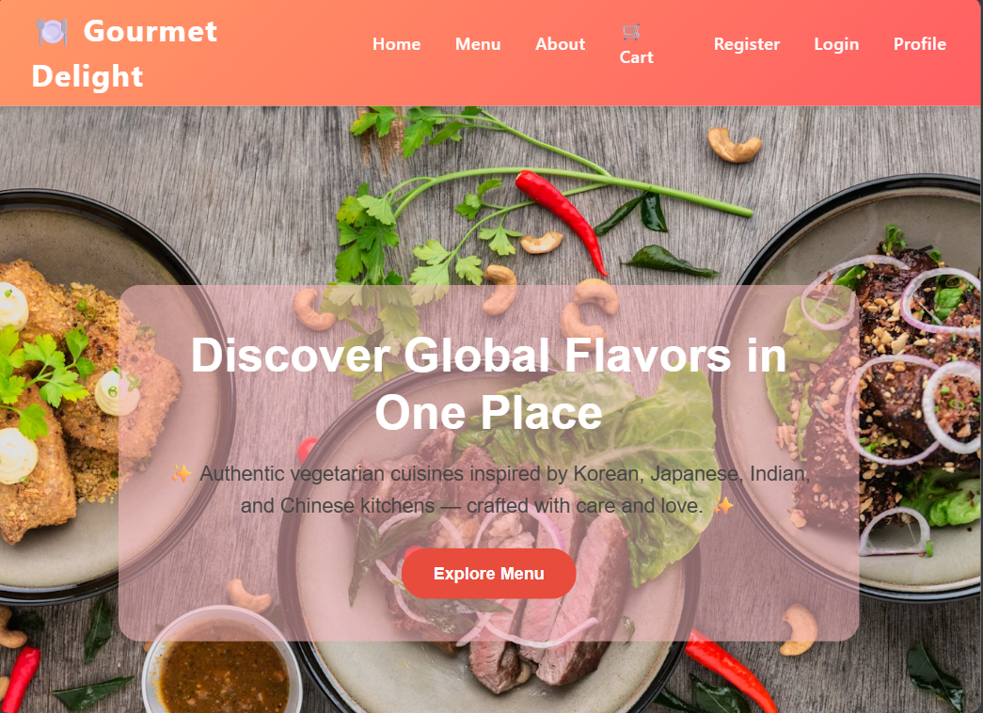
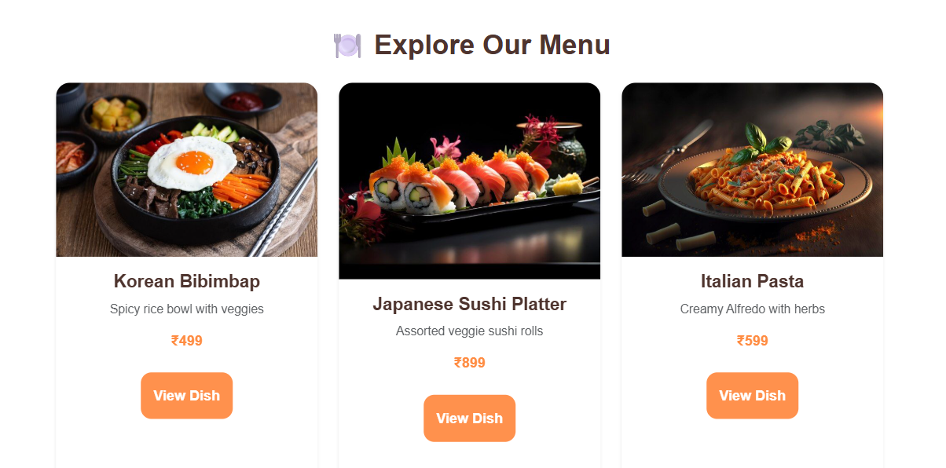
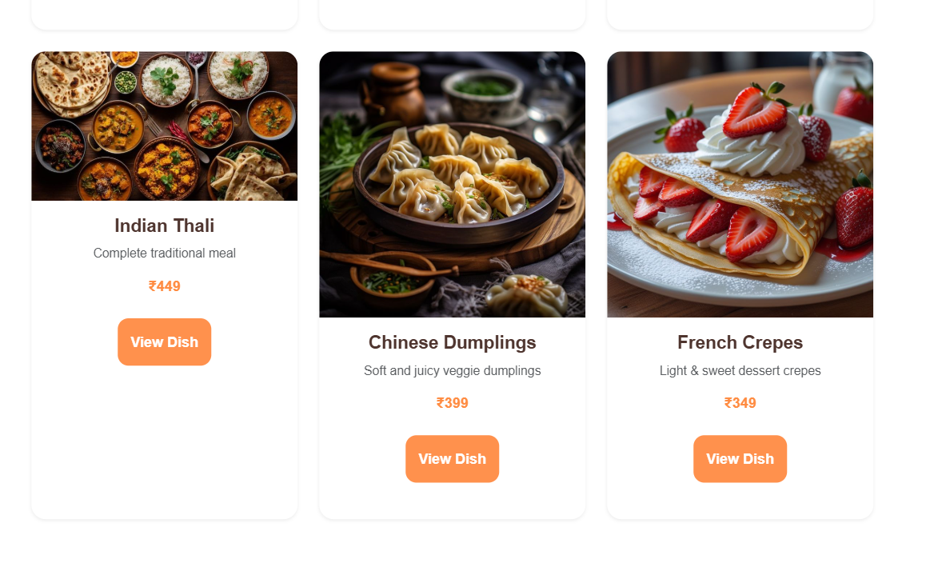
MIT School of Computing
Implementation & Results (Front-end)

Slide 7
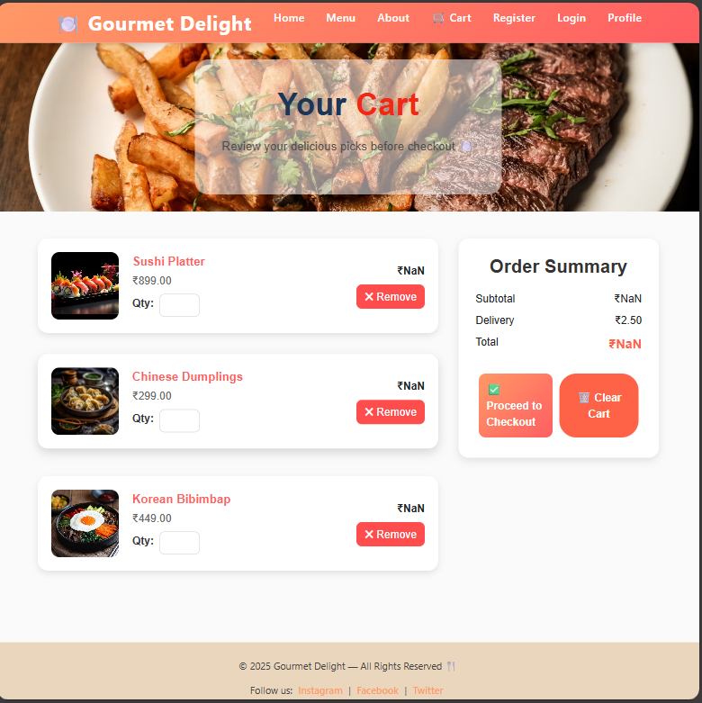
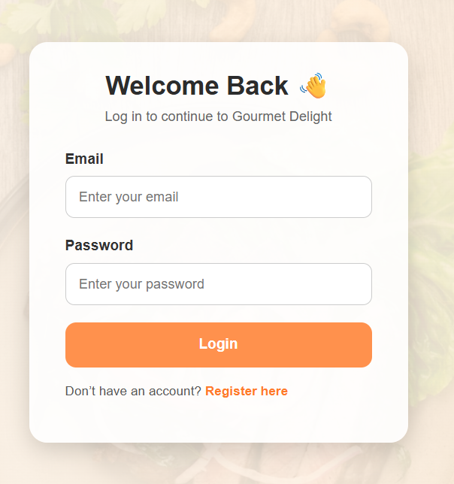
MIT School of Computing

Slide 8
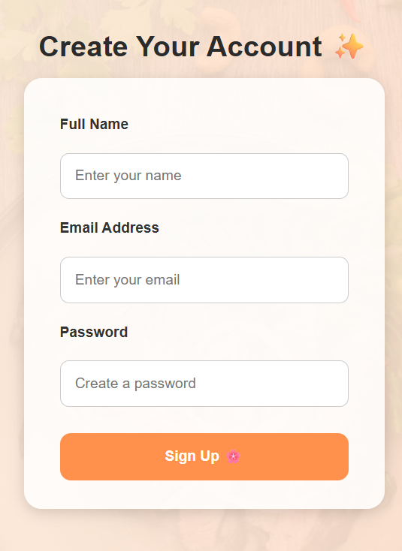
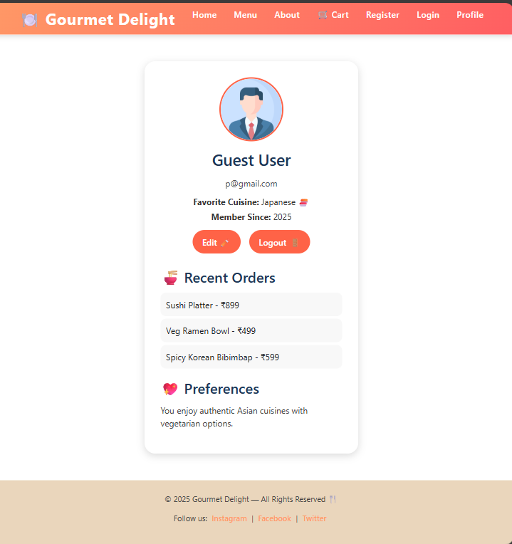
MIT School of Computing

Slide 9
MIT School of Computing
Challenges and Solutions
Challenge | Solution
React state management complexity | Used React Hooks
Navigation between pages | Used conditional rendering / React Router
LocalStorage persistence | Implemented logic to store user session data

Slide 10
MIT School of Computing
Conclusion and Future Scope
Successfully developed a fully functional and responsive Multi-Cuisine Restaurant Website showcasing diverse food categories & details attractively.
Gained hands-on experience in front-end development using HTML5, CSS3, JavaScript & React, focusing on responsive layouts, DOM manipulation & client-side data handling.
Enhanced understanding of user experience design, navigation flow & project structuring, resulting in a professional & aesthetically pleasing restaurant interface.
Future Enhancements:
Admin Dashboard for managing menu items, orders & user accounts.
Online Payment Integration using Razorpay or Stripe for secure transactions.
Order Tracking System to provide real-time updates to users.
Customer Reviews & Ratings section for better engagement & feedback.
Dark/Light Mode toggle to enhance user accessibility & design appeal.

Slide 11
MIT School of Computing
THANK YOU

